Slide 1
Which Landform am I?

Slide 2
I am located in the South West region of the United States. I am one of the seven natural wonders of the world. I was created from erosion. What popular landform am I?

Slide 3
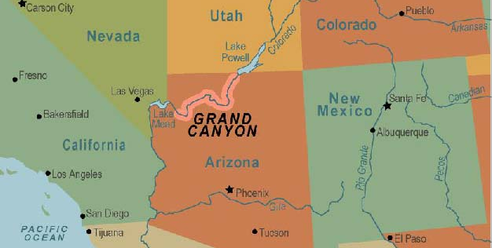
The Grand Canyon!
It is located in Northern Arizona.

Slide 4
A city in Utah is named after me. I am not as salty as the Dead Sea. I am fed by three major rivers and a few streams. What am I?

Slide 5
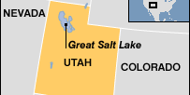
The Great Salt Lake!
It is located in Northwestern Utah.

Slide 6
I cover over 22,000 square miles in multiple states near the Grand Canyon. Most homes in my area are near springs or along trails. There are also some ghost towns where the economy has failed. What am I?

Slide 7
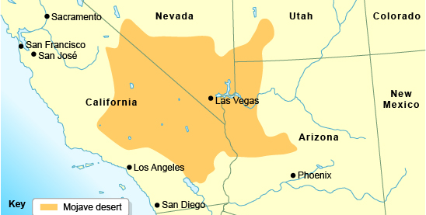
The Mojave Dessert!
It is located in Southern California, Nevada, Utah, and North Eastern Arizona.

Slide 8
I am located along the San Andreas Fault. I was created by a flood in 1905 of the Colorado River. What am I?

Slide 9
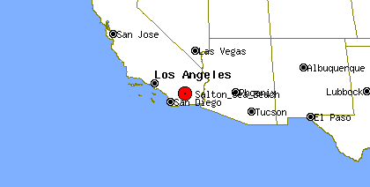
The Salton Sea!
It is located in Southern California.

