Slide 1
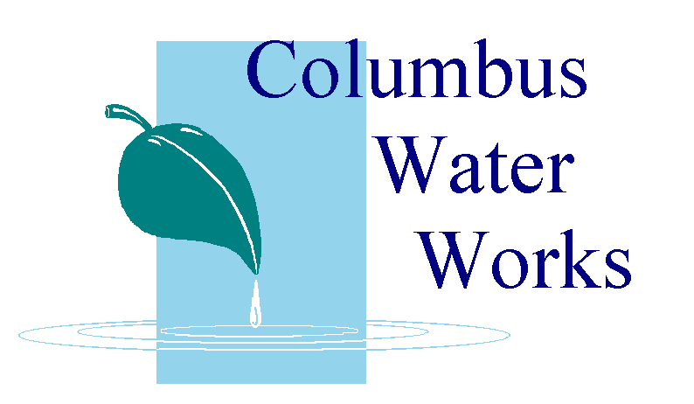
Water Quality Report for Columbus and
Fort Benning, Georgia
Columbus Water Works is pleased to report once again, that in 2010 drinking water for Columbus and Fort Benning has met or exceeded all US-EPA and State of Georgia drinking water standards this year.

Slide 2
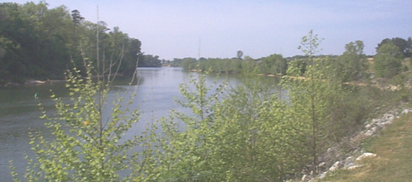
The sources of any drinking water (both tap and bottled water) can include rivers, lakes, streams, ponds, springs, naturally-occurring reservoirs, and wells.
Columbus’ source of drinking water is the Chattahoochee River, which is fed mostly by creeks, streams, and rain.
As water travels over the surface of the land or through the ground, it dissolves minerals and can pick up other substances resulting from the presence of animals or from human activity.

Slide 3
Contaminants that may be present in source water include:
Microbial (living) – pathogens such as viruses and bacteria which may come from human, agricultural or wildlife sources. This is why one doesn’t risk drinking untreated raw water, from the river or elsewhere.
Some sort of treatment is necessary to kill microbial pathogens.
Inorganic (non-living) – dissolved or suspended solids, such as mud, metals, and chemicals, which can be natural, or from storm water runoff, industrial or domestic waste water discharges, oil and gas production, mining or farming.
Again, some sort of filtration is needed to trap mud, silt, and other solids, and any pathogens, before safely drinking the water.

Slide 4
In order to ensure that tap water is safe to drink, the Environmental Protection Agency prescribes regulations which limit the amount of certain contaminants in water provided by public water systems.
The Food and Drug Administration regulations establish limits for contaminants in bottled water which must provide the same protection for public health.

Slide 5
Microbial Contaminants
Cryptosporidium
E.coli

Slide 6
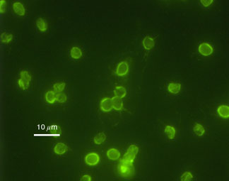
What is Cryptosporidium?
Cryptosporidium is a protozoan parasite too small (only 5 microns) to be seen without a microscope. It is common in surface waters (lakes and rivers), especially when these waters contain a high amount of sewage or animal waste.
Cryptosporidium can cause symptoms that include diarrhea, nausea, stomach cramps or all three. Because many other conditions can produce these same symptoms, a special lab test is needed to know if Cryptosporidium is the cause.
Samples of both untreated and treated water from our system have been sent to outside laboratories which can do Cryptosporidium testing. It may be (has to be) assumed that it is found in all source water everywhere.
Cryptosporidium has never been found in the drinking water that goes to your tap.

Slide 7
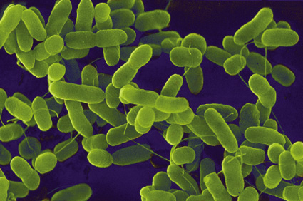
What is E.Coli?
E.coli is a bacterium that is commonly found in the lower intestine of all warm-blooded creatures. Most E.coli strains are part of the normal digestive tract, and are harmless, but some, such as type O157:H7, can cause serious food poisoning in humans, and are occasionally responsible for food product recalls. Cells are typically rod-shaped, and 2.0 microns long and 0.5 microns in diameter. A microscope is needed to view E.coli
Transmission of E. coli often occurs via unhygienic food preparation, farm contamination due to manure fertilization, irrigation of crops with contaminated water or raw sewage, wild pigs on cropland, or direct consumption of sewage-contaminated water. Dairy and beef cattle are primary reservoirs of E. coli O157:H7.
Food products associated with E.coli outbreaks include cucumber, raw ground beef, raw seed sprouts, spinach, raw milk, unpasteurized juice, unpasteurized cheese, and foods contaminated by infected food workers.
According to the Food and Drug Administration,
the transmission of E.coli can be disrupted by cooking
food properly, preventing cross-contamination, gloves for food workers, enforcing health care policies so food industry workers seek treatment when they are ill, pasteurization of juice or dairy products, and proper hand washing methods.
As with Cryptosporidium, E.coli has never been found the drinking water going to your tap.

Slide 8
Water Treatment Process for Eliminating Microbial Pathogens and Inorganic Solids from Drinking Water

Slide 9
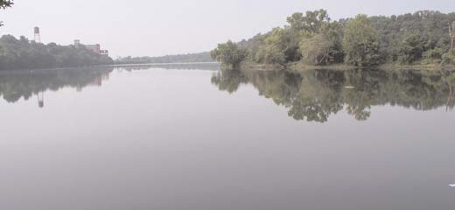
Water Treatment Process
1. Water coming in from the river is run through specially designed screens to capture large pieces of material, such as sticks and debris, and keeps them out of the treatment system.
(1) (2)
2. The next step is called sedimentation. Approved chemicals are added to the raw water in mechanical mixers to cause the mud particles to clump together, and they become heavy and sink to the bottom of the tanks. The water flows out and into another holding area, leaving the mud in the bottom of the tank. The ‘mud’ is collected and disposed of at the landfill.

Slide 10
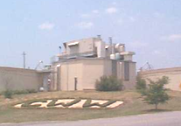
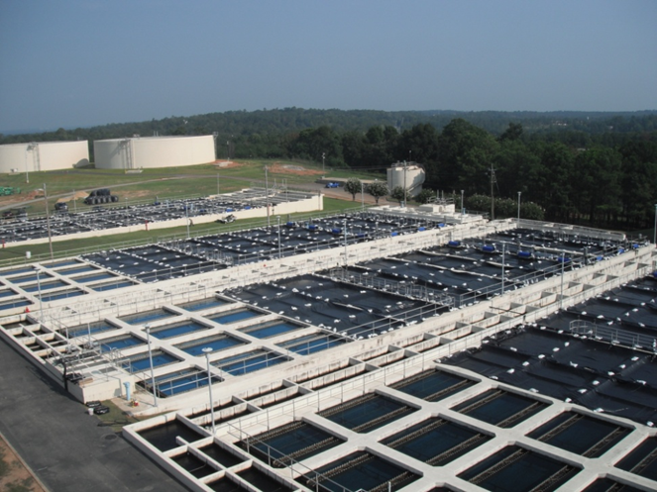
3. Next, the water is disinfected using Chlorine to kill all potentially dangerous microbes.
(3) (4)
4. After disinfection, the water passes through filters which remove any remaining particles from the water such as clays, silts, natural organic matter, and so forth.

Slide 11
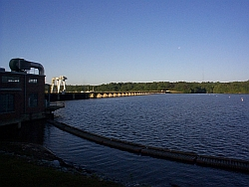
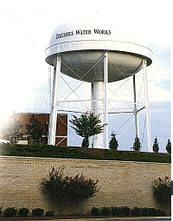
5. Once the water passes through the filters, more chlorine, lime, and fluoride are added, and the water, now called ‘finished water,’ is stored in holding areas called clearwells. (5) (6)
6. From there it will eventually be sent to home and businesses through a series of pipelines known as the distribution system. To ensure that the finished water from the treatment facilities remains safe for you and your family, the quality is regularly monitored by CWW's laboratory staff. In fact, the lab reviews approximately 225 samples a month taken from various locations in Columbus.

Slide 12
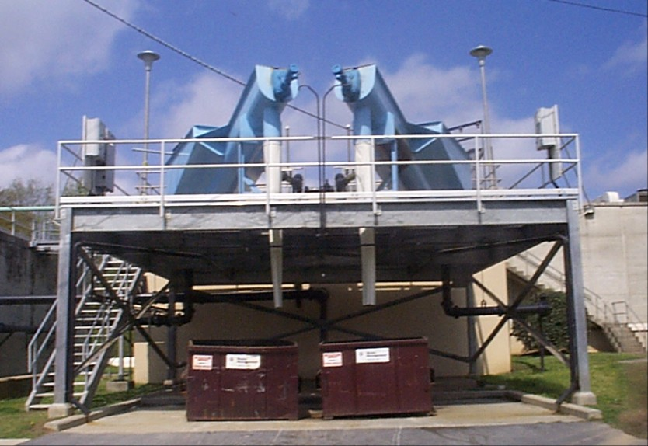
Wastewater Treatment Process
It's interesting to note that 99.9 percent of wastewater is actually H2-0. The rest can be called ‘solids’. The treatment process to bring wastewater to within regulated levels of purity before being discharged back into the river is broken down here into several phases:
1. Preliminary treatment - wastewater coming to the treatment plant from the city-wide sewage collection system, enters first through a device called a bar screen, to remove large solid pieces of debris. Sand and grit are also removed in this area. This helps to protect the mechanical units that house the other processes at the plant. Debris from the grit tank and bar screen is collected and sent to the city landfill.

Slide 13
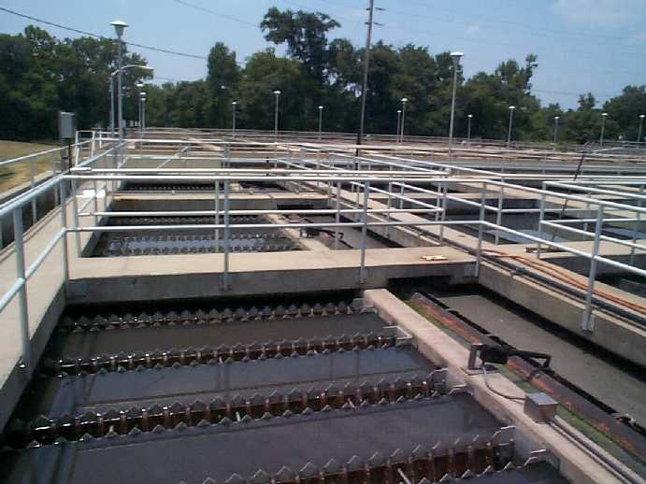
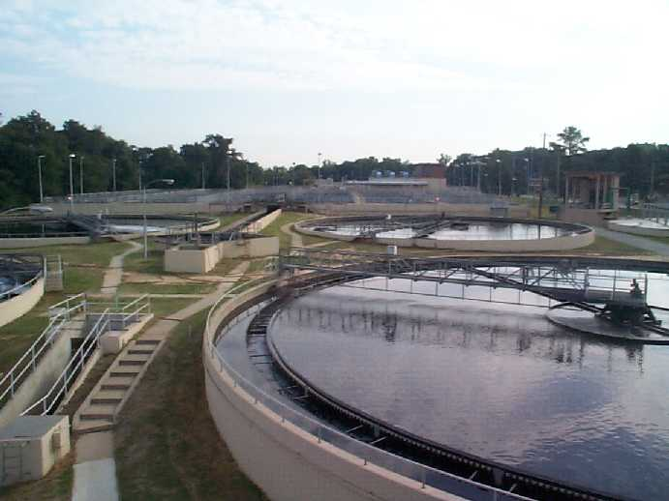
2. Primary treatment - wastewater is sent to primary settling tanks where the solids can settle to the bottom and greases can float to the top. This separation process takes a few hours. (2) (3)
3. Secondary treatment – The wastewater from primary treatment is sent on to pools called ‘aeration basins’. This phase relies on a biological treatment from certain naturally-occurring ‘good’ microorganisms that literally eat the organic material in the wastewater. The partially treated wastewater is mixed with air, which help the ‘good’ microorganisms multiply as they feed on the organic matter. This mixture is then sent to a tank known as the ‘final clarifier’ where the remaining solids settle to the bottom. The material on the bottom is then sent to the solids handling facility.

Slide 14
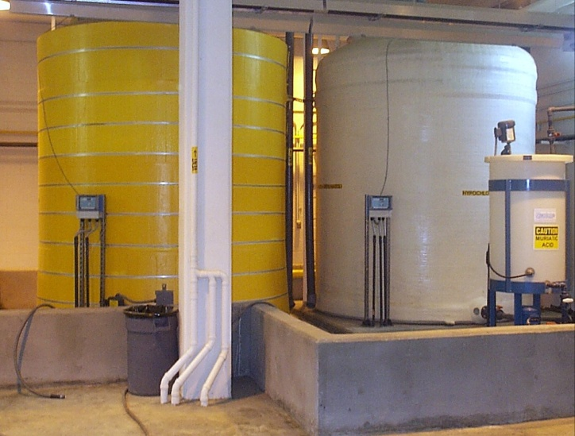
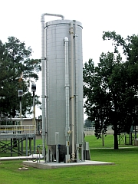
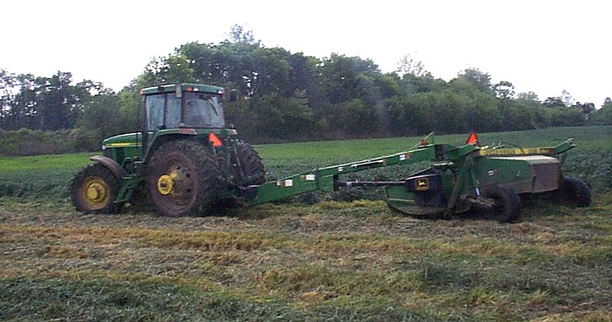
Wastewater Treatment Process (cont’d)
4. Final treatment – Chlorine is added to the wastewater after secondary treatment to kill any harmful microorganisms that might be present before it is discharged to the River. Then, before the water is discharged to the river, any remaining Chlorine content is neutralized.
The water that the Water Works puts back into the river is cleaner than the river water itself
(4) (5a) (5b)
5. Solids processing - solids from the primary settling tank and the clarifier (discussed above) are sent to an anaerobic digester (5a), which means oxygen is not necessary for the process. Like secondary treatment, this process also uses microorganisms to eat organic material resulting in a significant (90 - 95%) reduction in pathogens. The resulting product is a wet, soil-like material called ‘biosolids’ that contains 95-97% water. More filters are used to ‘squeeze’ the water away from the biosolids. These have the properties of a pure agricultural fertilizer, free of any pathogens, and are applied to certain farmers’ fields in our area (5b).

Slide 15
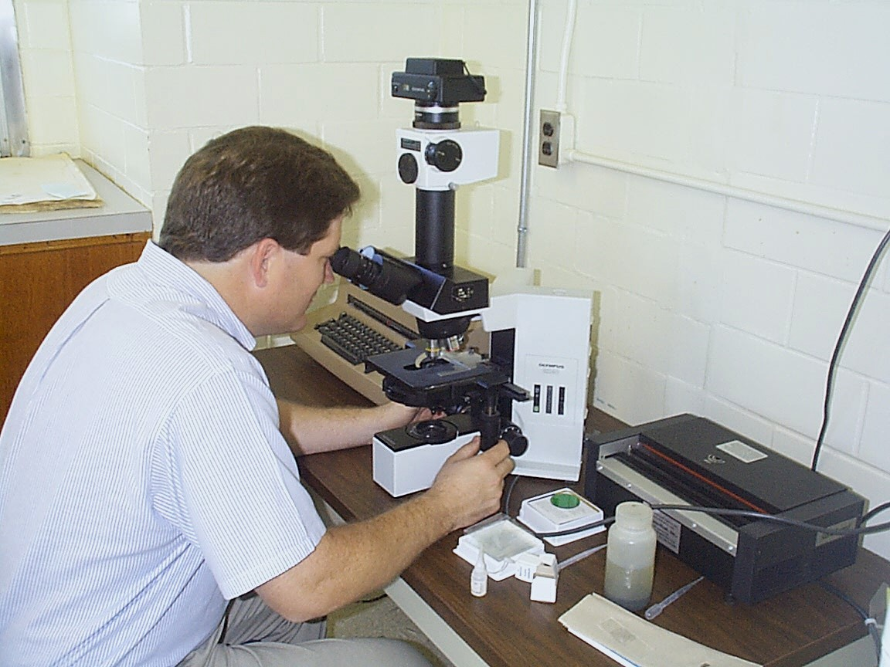
Laboratory
The Water Works laboratory staff carefully monitors the wastewater process, providing daily analysis of the raw water that comes into the plant from the river, and the waste water than is discharged back to the river.
The Lab staff also takes samples from sites in town connected to the its systems.
While these activities are mandated by State and Federal regulations, the Water Works takes its role as a steward of the environment very seriously. In fact, the utility has a contract with Georgia Environmental Protection Division to monitor water quality in the stretch of the Chattahoochee River in and around Columbus.

Slide 16
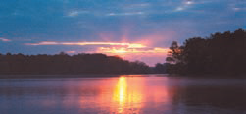

Thanks for your Participation Today

